Slide 1
Oracle/C++ Application Programming
Lecture 07 – Part 2
Week 08
DBS211

Slide 2
Agenda
Connecting to a Database
Executing SQL DDL and DML Statements
Types of SQL Statements in the OCCI Environment
Executing SQL Queries
Committing a Transaction
Handling Exceptions

Slide 3
Connecting to a Database

Slide 4
Creating and Terminating an Environment
All OCCI processing takes place inside the Environment class.
An OCCI environment provides application modes and user-specified memory management functions.
To create an OCCI environment
Environment *env = Environment::createEnvironment();
createxxx() methods are used to create OCCI objects such as
connections
Statements
At the end of your program, you need to terminate the OCCI environment:
Environment::terminateEnvironment(env);

Slide 5
Opening and Closing a Connection
The Environment class is the factory class for creating Connection objects.
Before creating a connection, you need to create the environment.
Use an environment instance to create a connection:
Environment *env = Environment::createEnvironment();
Connection *conn = env->createConnection("username", "password ", "Connection String");
You must terminate a connection at the end of the session.
env->terminateConnection(conn);
Environment::terminateEnvironment(env);

Slide 6
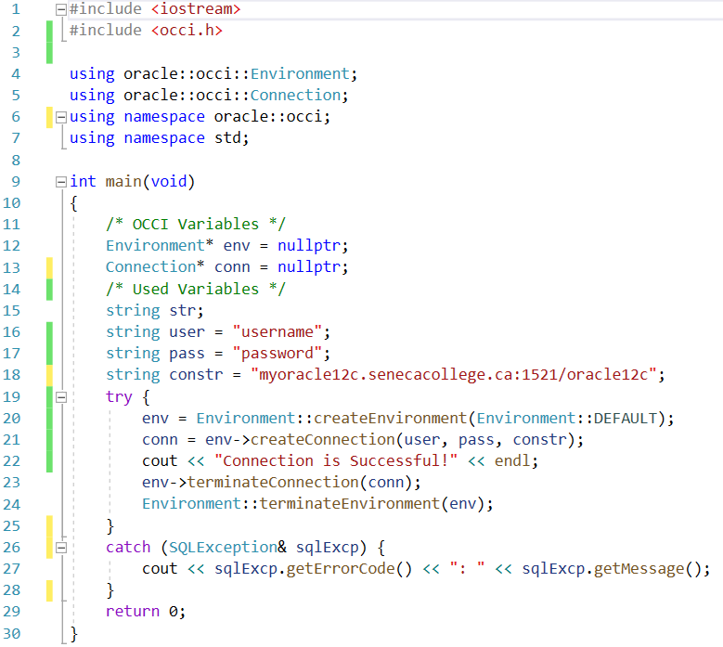
Creating a Database Connection

Slide 7
Executing SQL DDL and DML Statements

Slide 8
Creating a Statement Object
The Statement class is used to execute SQL commands.
To create a statement objects:
Statement *stmt = conn->createStatement();

Slide 9
Execute SQL Commands
After creating the statement object, the following methods can be called to execute SQL commands:
execute()
executes all nonspecific statement types
executeUpdate()
executes DML and DDL statements
executeArrayUpdate()
executes multiple DML statements
executeQuery()
executes a query
To creates a table in a database:
stmt->executeUpdate("CREATE TABLE student
(s_id NUMBER(4), name VARCHAR2(40))");
To insert values into a table
stmt->executeUpdate("INSERT INTO student
VALUES(10, ‘Sarah Stone')");

Slide 10
executeUpdate()
The executeUpdate() executes a SQL INSERT, UPDATE, DELETE, and a DDL statements CREATE/ALTER.
It returns the number of rows affected by the SQL statement execution.

Slide 11
Terminating a Statement Object
Terminate and deallocate a Statement object using the following statement:
terminateStatement()
See the following code that closes a statement object stmt:
Connection::conn->terminateStatement(Statement *stmt);

Slide 12
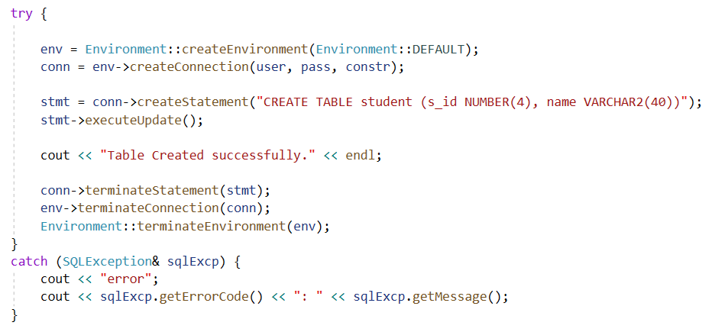
executeUpdate() – Create a Table

Slide 13
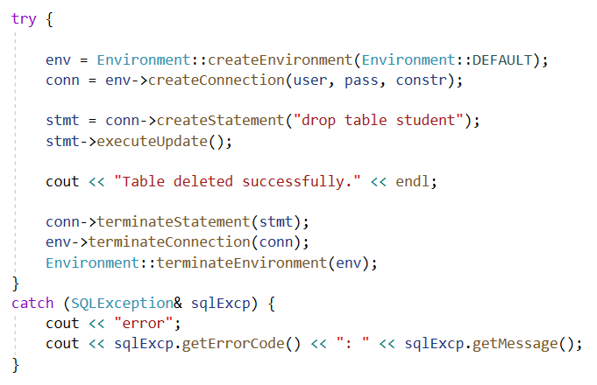
executeUpdate() – Drop a Table

Slide 14
createStatement - Example
or

Slide 15
Types of SQL Statements in the OCCI Environment
Oracle® C++ Call Interface
Programmer's Guide
12c Release 1 (12.1)
E48221-07

Slide 16
Types of SQL Statements
There are three types of SQL statements in OCCI.
Standard Statements
use SQL commands with specified values
Parameterized Statements
have parameters, or bind variables
Callable Statements
call stored PL/SQL procedures and functions

Slide 17
Standard Statements
In standard statements, the values are explicitly specified.
See the following example:
To creates a table in a database:
stmt->executeUpdate("CREATE TABLE student
(s_id NUMBER(4), name VARCHAR2(40))");
To insert values into a table
stmt->executeUpdate("INSERT INTO student
VALUES(10, ‘Sarah Stone')");

Slide 18
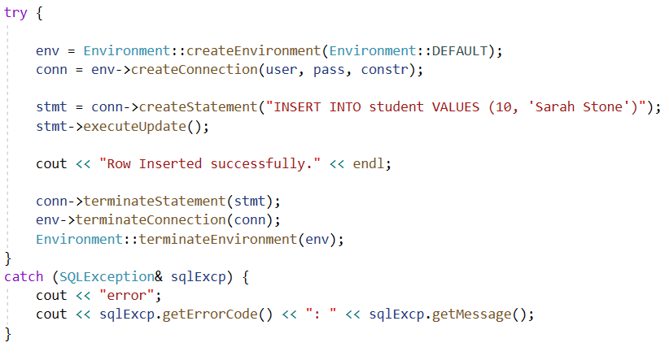
Standard Insert Statement

Slide 19
Parameterized Statements
A statement can be executed with different values using parameters as placeholders for the input values.
The setxxx() is used to specify parameters.
XXX stands for the type of the parameter.
See the following example:
setSQL("INSERT INTO student VALUES (:1,:2) ");
You first need to specify the statement using the setSQL() method.
stmt->setInt(1, 1003); // value for first parameter
stmt->setString(2, "Nick Shine"); // value for second parameter
stmt->executeUpdate(); // execute statement
...
stmt->setInt(1, 1004); // value for first parameter
stmt->setString(2, "Adam Sandler"); // value for second parameter
stmt->executeUpdate(); // execute statement

Slide 20
setSQL( )
The setSQL() method is used to reuse a statement object to store and execute a SQL statement multiple times.
setSQL("INSERT INTO student VALUES (:1,:2) ");
The getSQL() method can be called to the content of the current statement.
To reset a statement object, call serSQL() method with the new SQL statement.
stmt->setSQL("SELECT * FROM inventories WHERE quantity < :1");

Slide 21
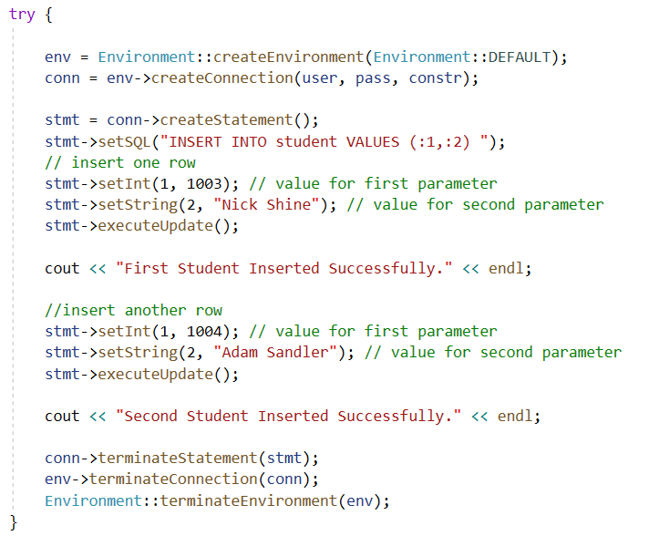
Parameterized Insert Statement

Slide 22
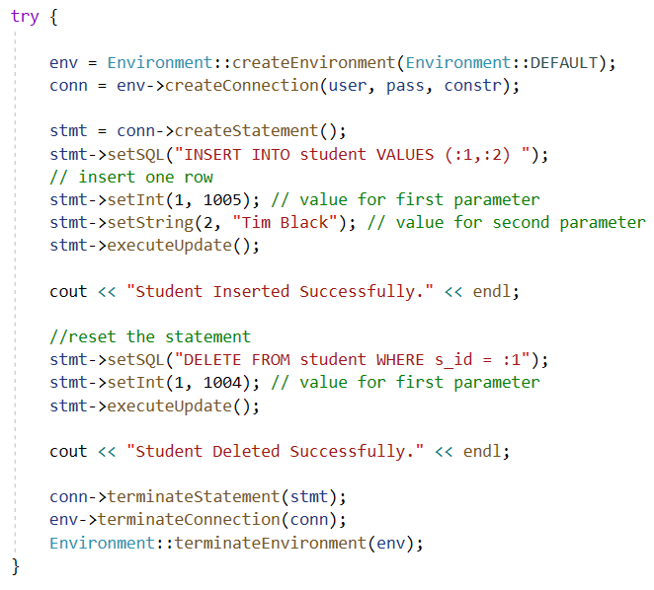
Reset Statement Objects
The method setSQL() can b used to reset a statement object to be used for a different SQL statement.

Slide 23
Callable Statements
PL/SQL stored procedures are procedures stored on a database server which can be called inside a database or by an application.
First define the statement to be executed:
stmt->setSQL("BEGIN countStudents(:1, :2); END:");
The above command will call the countStudents stored procedure that has two parameters.
First parameter is an IN parameter. It gets the value of PGM (program). The stored procedure will then find the number of students in the “CPA” program.
stmt->setString(1, "CPA");
The second parameter is an OUT parameter. It stored the number of students in the “CPA” program and the values will be returned to the caller.
int count; // this variable stores the returning value from the countStudent() procedure
stmt->registerOutParam(2, Type::OCCIINT, sizeof(count)); // specify type and size of the second (OUT) parameter
And finally, execute the statement to call and execute the stored procedure.
stmt->executeUpdate(); // call the procedure
Now, save the returning value of the OUT parameter in the count variable.
count = stmt->getInt(2);

Slide 24
Executing SQL Queries
An application fetch information from a database by executing SQL queries.
You can execute a query and store a result into a result set object.
See the following example:
ResultSet *rs = stmt->executeQuery("SELECT * FROM student");
The result of the above query is stored in rs.
cout << "The CPA program has:" << endl;
while (rs->next())
{
int count = rs->getInt(1); // get the first column as int
string name = rs->getString(2); // get the second column as string
cout << count << " " << students << endl;
}
You can perform operations on data in the result set.
The next() method is used to fetch the next row.
The getXXX() is used to fetch the value of a column.

Slide 25
ResultSet Class
A ResultSet provides access to the result of a query.
It provides a cursor pointing to the current row.
The cursor initially is pointing to the position before the first row.
The next() method moves the cursor to the next row.
The getxxx() method is used to fetch the value of a column.
ResultSet::getxxx()
while (rs->next())
{
int count = rs->getInt(1); // get the first column as int
string name = rs->getString(2); // get the second column as string
cout << count << " " << students << endl;
}

Slide 26
Query with Variables
Variables can be used to specify values in the WHERE clause of a SQL query.
We want to find students with gpa 3.2:
stmt->setSQL("SELECT * FROM student WHERE gpa >= :1");
float gpa = 3.2;
stmt->setFloat(1, gpa); // set the parameter
ResultSet *rs = stmt->executeQuery();
cout << "The students with GPA 3.2:" << endl;
while (rs->next())
cout << rs->getInt(1) << " " << rs->getString(2) << endl;

Slide 27
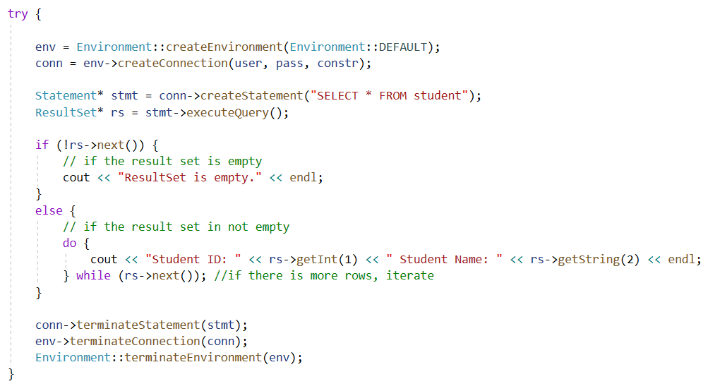
Standard SQL Query

Slide 28
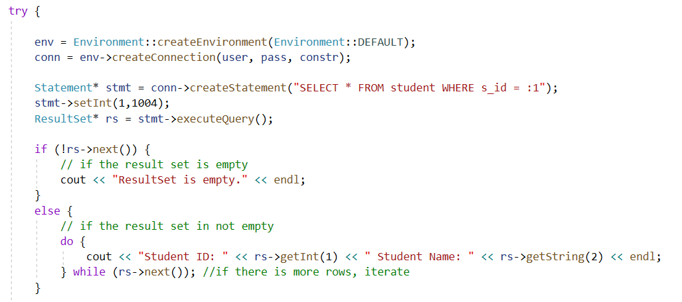
SQL Query with Parameters

Slide 29
getXXX() Methods
Method | Description
getDate() | Return the value of a parameter as a Date object
getDouble() | Return the value of a parameter as a C++ double.
getFloat() | Return the value of a parameter as a C++ float.
getInt() | Return the value of a parameter as a C++ int.
getNumber() | Return the value of a parameter as a Number object.
getString() | Return the value of the parameter as a string.

Slide 30
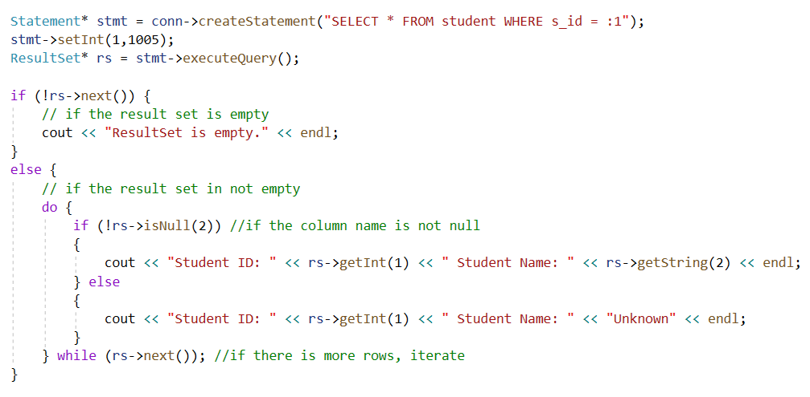
isNull() Method
Checks whether the parameter is null.

Slide 31
setXXX() Methods
Method | Description
setDate() | Set a parameter to a Date value.
setDouble() | Set a parameter to a C++ double value.
setFloat() | Set a parameter to a C++ float value.
setInt() | Set a parameter to a C++ int value.
setNull() | Set a parameter to SQL null.
setNumber() | Set a parameter to a Number value.
setString() | Set a parameter to an string value.

Slide 32
Transactions
Changes by DDL statements become permanent after committing the transaction or reversed by rollback.
Commit and Rollback commands can be execute when using executeUpdate().
Connection::commit()
Connection::rollback()
To make changes of DML statements permanent immediately, execute the following command:
Statement::setAutoCommit(TRUE);
To set the auto commit off:
Statement::setAutoCommit(FALSE);

Slide 33
Handling Exceptions
OCCI methods generates exceptions of type SQLException if they are unsuccessful.
The SQLException class contains Oracle specific error numbers and messages.
The error message can be obtained by the exception::what() or getMessage() method.
The getErrorCode() returns the Orcale error code.
See the following examples:
catch (exception &excp)
{
cerr << excp.what() << endl;
}
catch (SQLException &sqlExcp)
{
cerr <<sqlExcp.getErrorCode << ": " << sqlExcp.getErrorMessage() << endl;
}
catch (exception &excp)
{
cerr << excp.what() << endl;
}

